Slide 1

INTERNET OF THINGS
Connecting Smart Objects
Dr. Nagegowda K S
Department of Computer Science & Engineering

Slide 2

INTERNET OF THINGS
Chapter4: Connecting Smart Objects
Dr. Nagegowda K S
Department of Computer Science & Engineering

Slide 3
INTERNET OF THINGS
Agenda
Communication Criteria
IoT Access Technologies

Slide 4
INTERNET OF THINGS
Communication Criteria
Range
Frequency Bands
Power Consumption
Topology
Constrained Devices
Constrained Node Networks

Slide 5
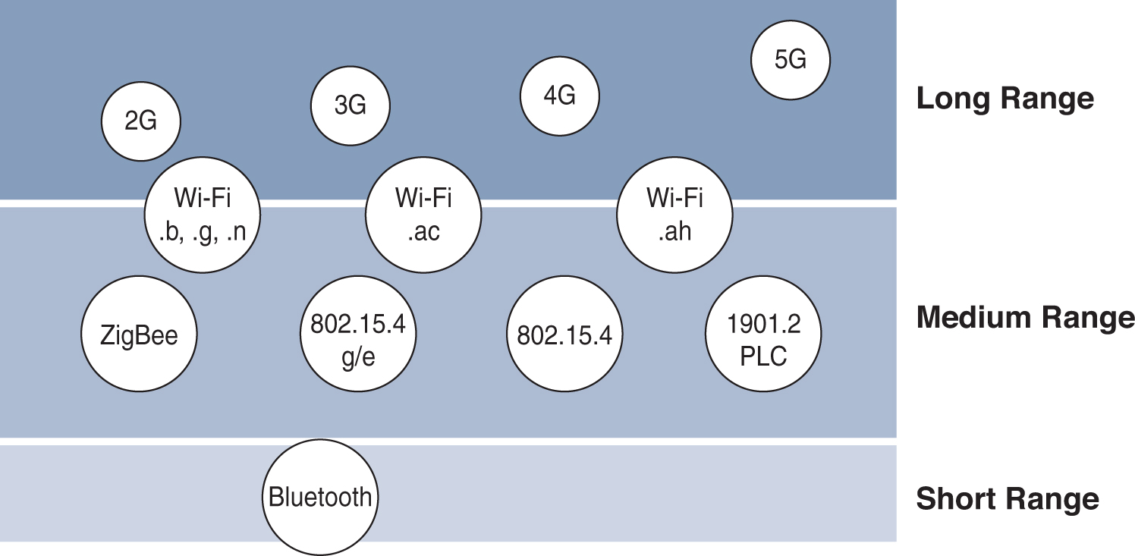
INTERNET OF THINGS
Communication Criteria- Range
Figure - Wireless Access Landscape

Slide 6
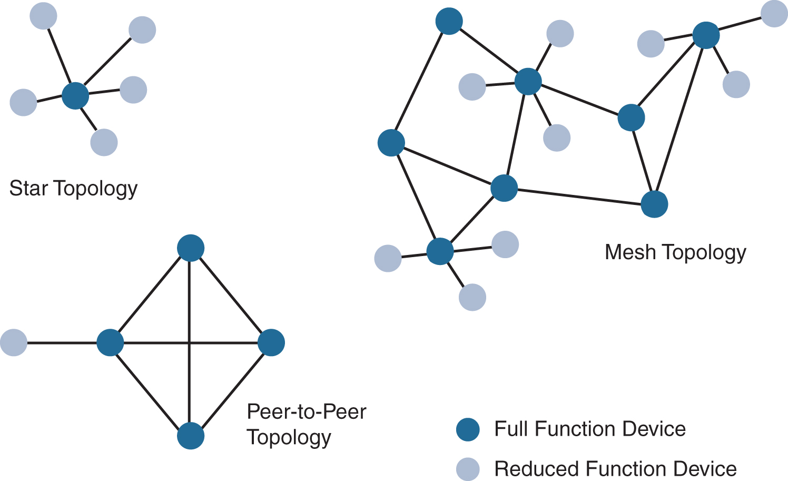
INTERNET OF THINGS
Communication Criteria- Topology
Figure - Star, Peer-to-Peer, and Mesh Topologies

Slide 7
INTERNET OF THINGS
Communication Criteria- Constrained Devices

Slide 8
INTERNET OF THINGS
Communication Criteria- Constrained-Node Networks
Data Rate and Throughput
Latency and Determinism
Overhead and Payload

Slide 9
THANK YOU
Dr. Nagegowda K S
Department of Computer Science & Engineering
nagegowda@pes.edu

